Slide 1
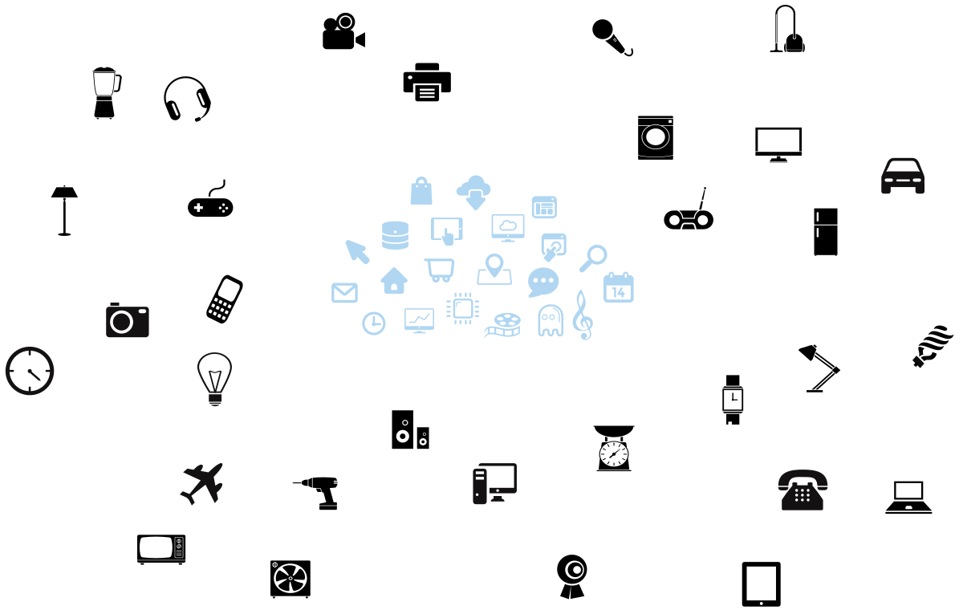
TrustShadow: Shielding IoT Application from Hostile Environment [MobiSys’2017]
Image source: https://iot.mozilla.org/about/
Notes:
I have introduced my work on protecting critical data in an application.
In the following, I will introduce my second work, which can protect a whole application for IoT devices,
Which run run Linux OS on ARM.
TrustShadow addresses the problem of executing an unmodified application in a compromised OS for ARM platforms.
Existing shielding work mainly focus on x86 platform, utilizing SGX or hypervisor.
However, SGX is not available for ARM platform, and hypervisor is an overkill for embedded or IoT settings.
In this work, I leverage a lightweight security feature called TrustZone to achieve shielded execution.
In fact,
Bring shielded execution to “Linux on ARM” systems is of great importance.
because we are surrounded by billions of such low-cost device.

Slide 2
Kernel Exploits in Recent Years
Canary Based Kernel Stack Protection
Real-time Kernel Protection
Kernel ASLR
Kernel vulnerabilities continue to be revealed in spite of various of sophisticated defense techniques.
Kernel Patch Protection
Linux Security Modules
SELinux
Data source: http://www.cvedetails.com/
Notes:
However, these devices are facing serious threats from vulnerable Linux kernel.
Kernel vulnerabilities are reported every month, and exiting software-based solutions,
including kernel ASLR, kernel stack protection, real-time kernel protection, all seem to be inefficient.
This motivates us to find a hardware-assisted solution to shield the trusted applications even if the OS is compromised.
第二个事情是关于内核的安全漏洞。近十几年来，针对操作系统内核，已有很多安全增强机制，然而不幸的是，Linux内核的漏洞数并没有下降，反而逐年增长。这说明这些软件防护方案并没有有效的解决问题。

Slide 3
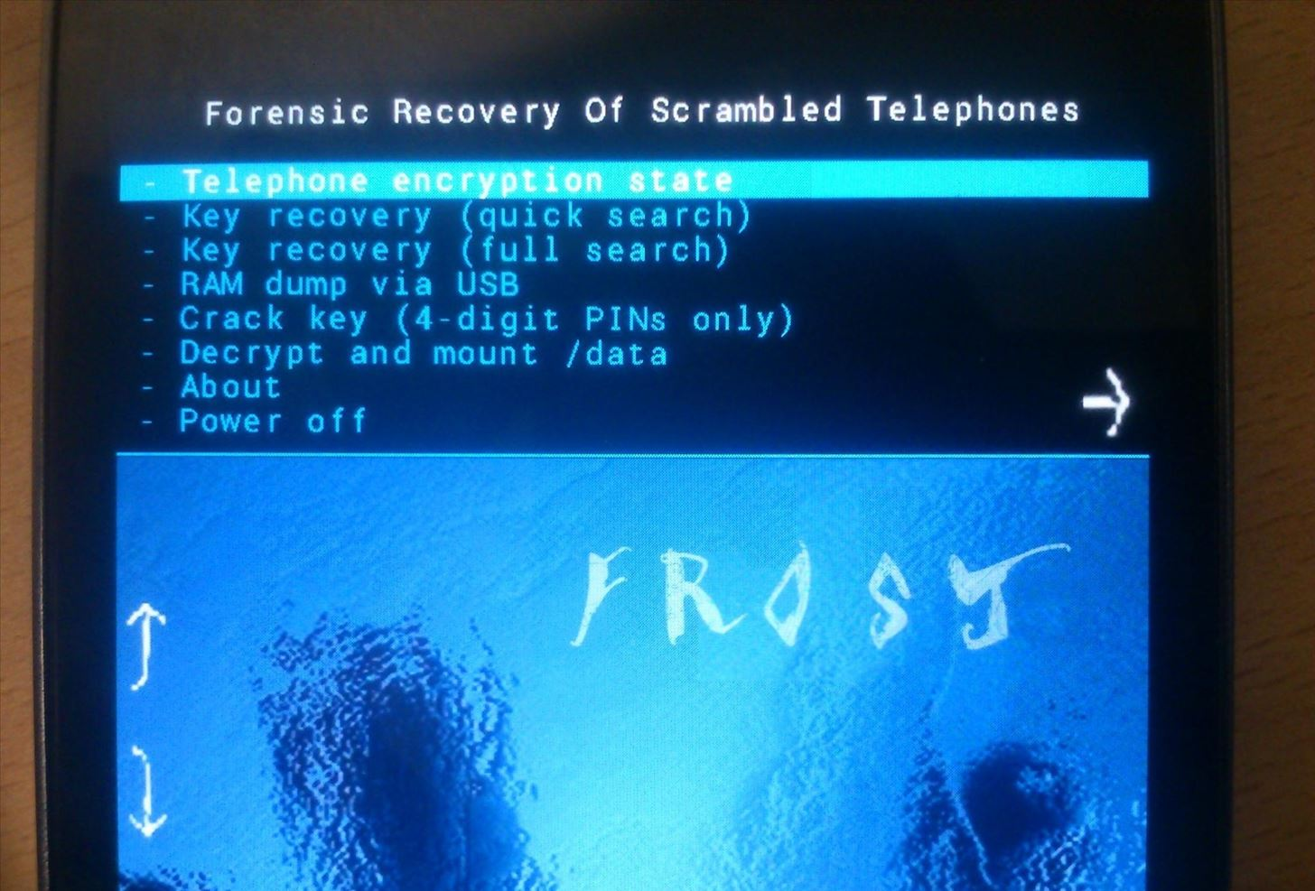
Physical-space Threats for ARM Devices
Image source: https://www1.informatik.uni-erlangen.de/frost
Notes:
Besides that, researchers have found that smartphones are also vulnerable to physical attacks such as cold boot attack.

Slide 4
Design Goals
Cyber-space Security
Load-time integrity
Run-time isolation
OS returns genuine results
Encrypted I/O
Physical-space Security
Instant Adoption
Memory encryption
1
Legacy application support
Legacy hardware support
2
3
Notes:
TrustShadow tackles attacks from both cyber space and physical space.
Regarding cyber-space, we assume a compromised OS. And ensures a trusted program is loaded into the memory correctly,
and the compromised OS cannot access the memory of the trusted program.
In addition, we verify the system call returns to defeat iago attacks.
We also transparently encrypt the file before they are written into the disk.
Regarding physical space, we encrypt data segment of a trusted program to defeat cold boot attack.
Finally, we support unmodified programs, therefore, protection can be deployed right away.,
In this work, we propose trustshadow, a mechanism specifically designed for ARM platform to shield a trusted application from malicious OS.
We design our system to work with the ARM platform without relying on hypervisor, and requires no modification to legacy programs.
As a result, we solution can be instantly deployed in existing ARM devices.
In terms of security, trustshadow ensures program integrity by verifying the hash value when a page is loaded into the memory.
During execution, the program runs in an isolated execution with the OS. As a result, a compromised OS cannot interfere with its execution.
We also ensure that the OS provides system services to a trusted application genuinely.

Slide 5
Background on ARM TrustZone
Non-secure
Normal World
Secure World
Secure
App 1
App 2
Trustlet
Trustlet
Cannot protect legacy code
Doesn’t support memory encryption
Commodity Operating System
Trusted OS
Software
Monitor
Hardware
Non-secure
Peripherals
Non-secure Region
Secure Region
Secure
Peripherals
Processor
Notes:
Too much color
Before presenting the details of TrustShadow, we first have a look at the ARM TrustZone extension in ARM architecture.
ARM TrustZone was firstly introduced to the ARM v6 architecture. Since then, almost all ARM’s application processors are
Empowered with this feature.
ARM TrustZone provides two virtual cores, one for the normal world and the other for the secure world. Accordingly, the system
Resources are partitioned to secure ones and non-secure ones.
The normal world can only access non-secure resources, and usually runs a commodity OS.
The secure world could access both secure and non-secure resources, and usually runs a trusted lightweight OS.
Each world has its own user mode and privileged mode, except that there is an additional monitor mode in the secure world, which serves
As a gate for world switches.
In its original design, applications in the normal world needs to invoke API across the world to call security services in the secure world.
Therefore, it cannot protect legacy code.
Besides, it doesn’t support memory encryption either.

Slide 6
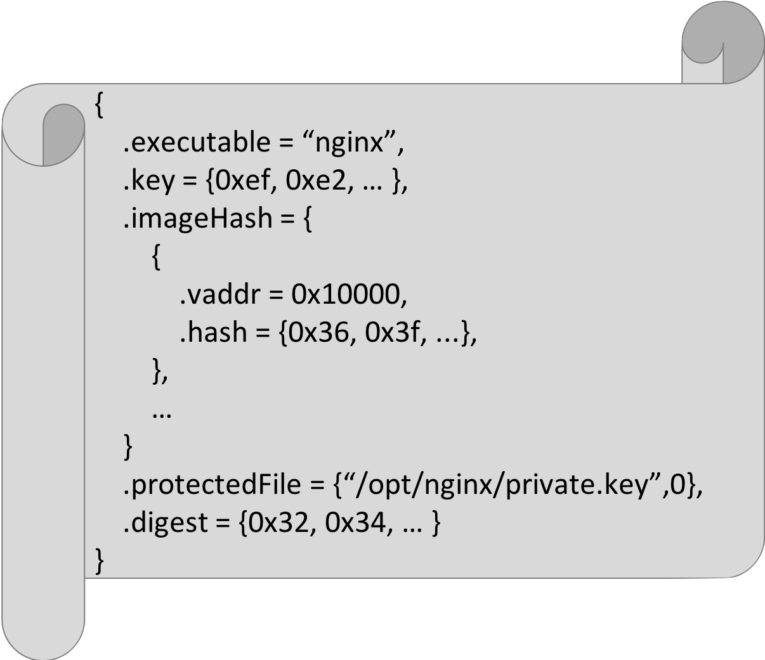
TrustShadow Overview
Normal World
Secure World
App 1
Trusted
App
Trusted
App
Trusted
App
Linux Kernel
Runtime System
Software
Forwarder
Monitor
Non-secure
Peripherals
Non-secure Region
Secure Region
Secure
Peripherals
Processor
Hardware
Notes:
TrustShadow aims to execute a trusted application in the secure world, thereby isolating it from the Linux kernel.
However, the process is still managed by Linux, in other word, there is a task_struct for each trusted process.
The physical pages of a trusted process are allocated by Linux, however, it cannot access them because they are secure resources.
In the secure world, the runtime system communicates with the Linux kernel to construct the execution environment for the trusted process, for example, the page table.
However, it also verifies the correctness of the results from Linux.

Slide 7
Bundled Manifest
{
.executable = “nginx”,
.key = {0xef, 0xe2, … },
.imageHash = {
{
.vaddr = 0x10000,
.hash = {0x36, 0x3f, ...},
},
…
}
.protectedFile = {“/opt/nginx/private.key”,0},
.digest = {0x32, 0x34, … }
}
Notes:
To achieve this, we install a profile for each trusted process.
In this example, we assign the nginx’s encryption key for I/O. The hash values of the code page.
Which file should be protected. Finally, there is a signature of the profile.

Slide 8
Workflow of a Trusted Process
Cyber Security
Integrity
Isolation
Genuine
Genuine Returns
I/O Encryption
Physical Security
Memory Encryption
System Call
Iago attack checking
Page Fault
Hash checking
Memory encryption
I/O encryption
Execute in Secure World
Forward External Service
Internal Service
Never Execute in Normal World
Normal World
Secure World
User
mode
USR
USR
Privileged
mode
SVC
ABT
IRQ
SVC
ABT
IRQ
MON
Notes:
This slide shows the workflow of a trusted application. And how the security features can be enforced.
A trusted application is still created in the normal world by the Linux kernel in SVC mode.
Here SVC mode is the mode where kernel runs.
However, it never gets scheduled to run the normal world, instead, TrustShadow
Invokes a world switch when the app is scheduled.
The monitor mode is transferred to SVC mode and further to user space to execute.
When an exception happens, the processor will be trapped into the corresponding CPU mode.
For some security critical service requests, such as a RNG requests,
Our runtime system directly serve them in the secure world, and returns.
For most of them, our runtime system simply forwards them to the normal-world Linux OS.

Slide 9
Page Table Update with Integrity Checking
Load code page & allocate secure page
Install normal-world PTE
Verify S-Page
Install secure-world PTE
Copy N-Page to S-Page
Hash validation
Physical Memory
ZONE_TZ_APP
Within ZONE_TZ_APP
No double mapping
(vaddr, hash)
S-Page
ZONE_NORMAL
N-Page
Untrusted Page Table
Trusted Page Table
0x403E1000
RW
0x403E1000
RX
ZONE_TZ_RT
……
RW
……
RX
……
RW
……
RX
Notes:
Let’s look at a concrete example of how Trustshadow verifies the behavior of Linux kernel.
Specifically, how TrustShadow handles page fault request caused by instruction fetching.
As shown in the figure, the physical memory is partitioned into 3 parts.
ZONE_NORMAL is dedicated for the normal-world Linux kernel and normal processes.
ZONE_TZ_RT is for the runtime system in the secure world.
And ZONE_TZ_APP is dedicated for trusted applications.
When a page fault is taken,
the Linux kernel loads the corresponding code page into a normal page,
And also allocate a secure page.
Then it installs the PTE.
Third, the runtime system verifies the secure page.
Specifically, is it really inside ZONE_TZ_APP?
Is there a double mapping occurring?
Then the secure world PTE is installed,
And the code it copied from the normal page to the secure page.
Finally, the runtime system verifies its integrity
By comparing its hash value with a one stored in the runtime system.
Note that we perform the hash validation in the last step to avoid
Time to checkout to time to use attacks.

Slide 10
Comparison with Intel SGX
 | TrustShadow | Intel SGX
Isolation
Measurement
Attestation
Sealing
Memory Encryption
Flexibility
Unmodified OS
Unmodified Program
Notes:
To support this feature, the remote entity and the device
manufacture need to establish a trust to digitally sign the
“quote”.

Slide 11
Summary
Programmable “SGX” with TrustZone
Reduced TCB
Resource management VS. verification
Observation of program behaviors
Controlled-channel attacks [Oakland’15], etc.
No comprehensive protection from Iago attack
Library OS for Linux
Graphene [Eurosys’14]
43 host ABI
Notes:
In conclusion, we bring many SGX functions to ARM platform using TrustZone.
Since TrustZone is lightweight, TrustShadow is more suitable to be employed in embedded and IoT environment.
In our design, the Linux kernel allocates resources for trusted processes, but it cannot access them.
This design grealy reduces the TCB of our runtime system.
However, our design still exposes a lot of program behaviors to the Linux kernel, thus might be subject to side channel attacks.
Finally, we have not deployed comprehensive defense to Iago attacks, because checking all the system calls is cumbersome.
Instead, we could include a Library OS into the TCB of system, so as to narrow down the system call interface to be checked.
protecting enclaves from malicious privileged software while retaining OS-level management of physical resources using traditional mechanisms.

